Slide 1


Assignment 1: Data visualization using tableau
Group Members
Hilal Ilcin - M00912970
Thu Thao (Alex) Le - M00939507
Thi Hong Nhung (Katty) Nguyen - M00964642
Jennifer Angelina D. - M00957714
Muhammad Younas - M00789966
10 November 2023

Slide 2
CONTENTS
1
Find a pattern for one of the measurements
2
Find a relationship between two or three measurements

Slide 3
FINDING 1

Slide 4
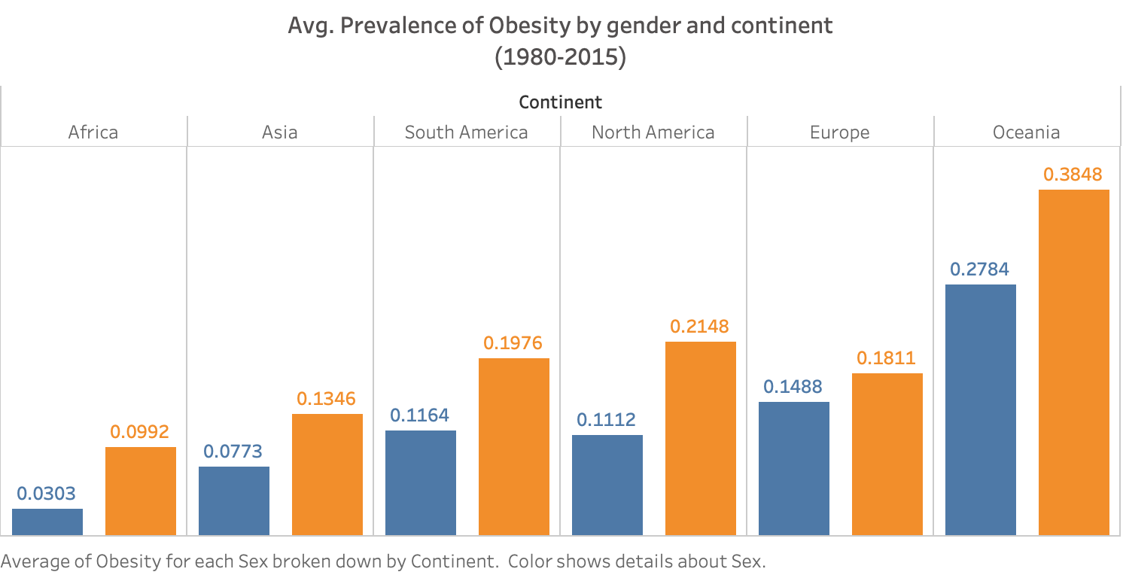
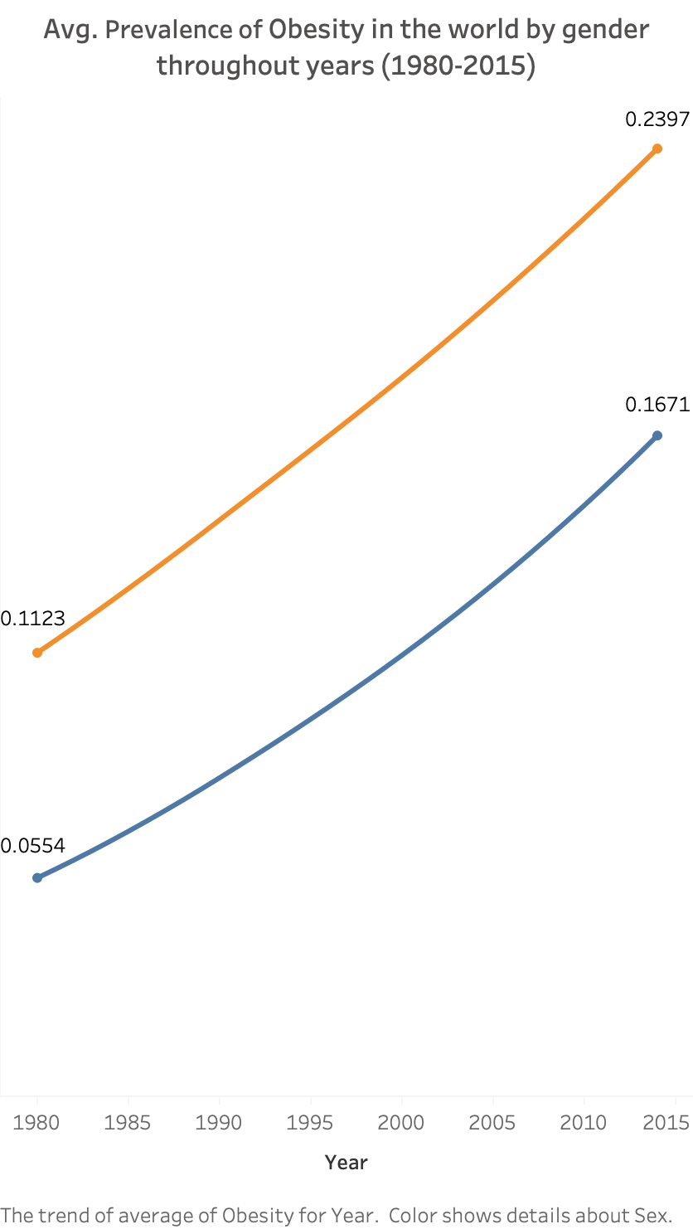
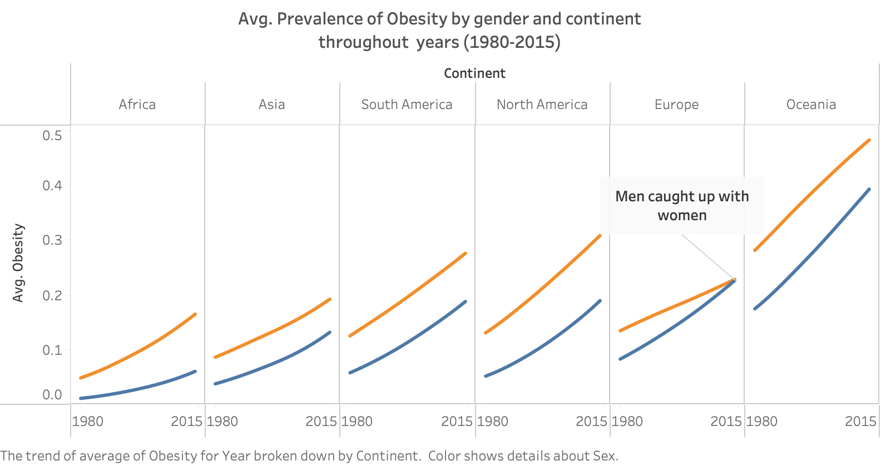
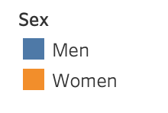
From 1980 to 2015, both men's and women’s avg. % of obesity were increasing but women's was always higher than men's.
The same trend that women’s obesity was always higher than men's across all continents.
However, through years, Europe was different, the men caught up with women​ for the first time.

Slide 5
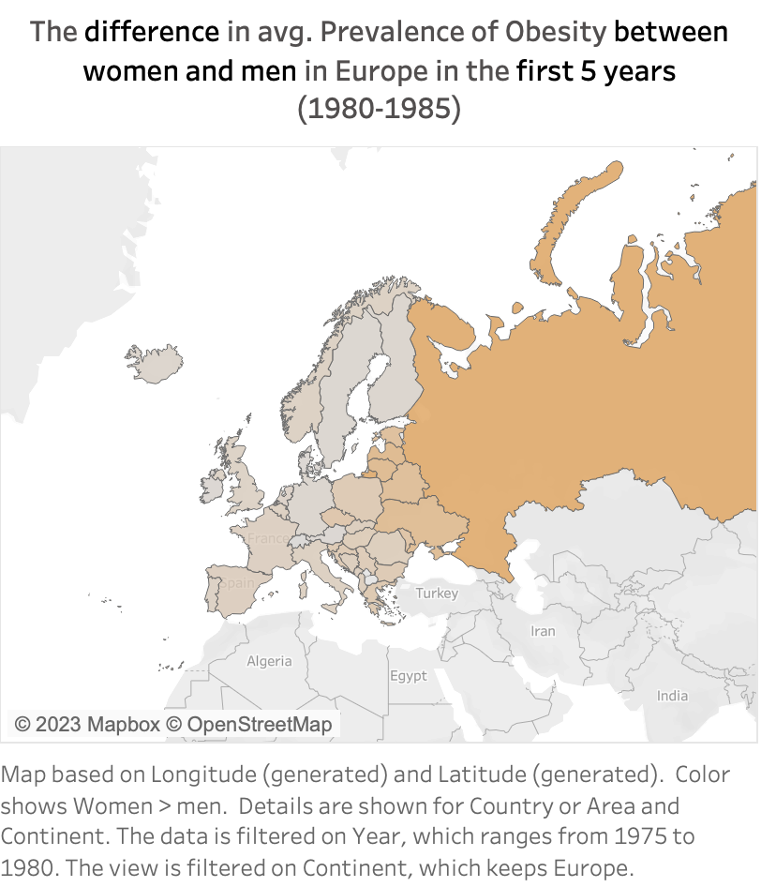
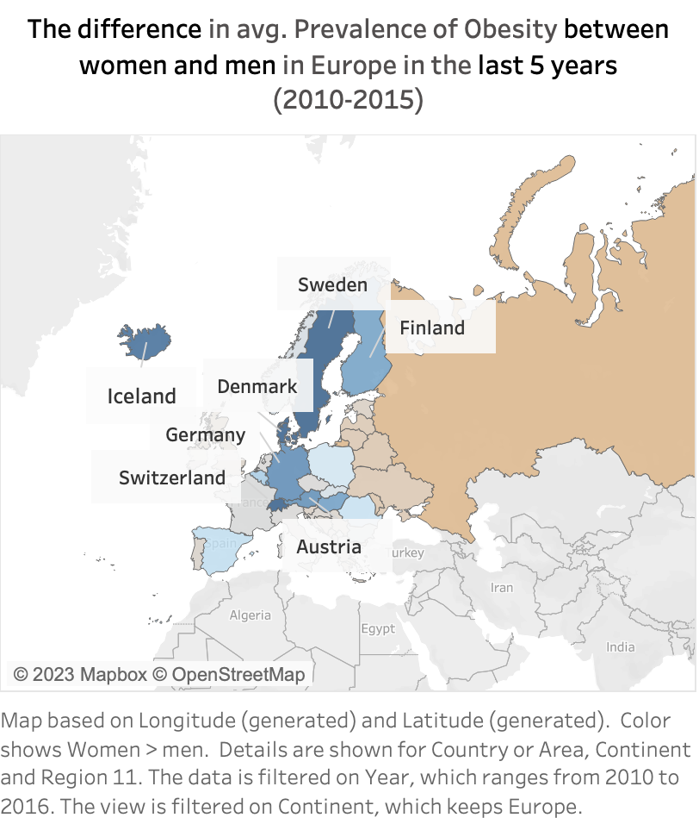

In Europe, for the first 5 years, all the countries had women’s average obesity higher than men’s. However, for the last 5 years, the trend changed as there were some countries (Sweden, Denmark, Germany, Switzerland, Iceland, Austria, Finland) having men’s values higher than women’s.

Slide 6
FINDING 2

Slide 7
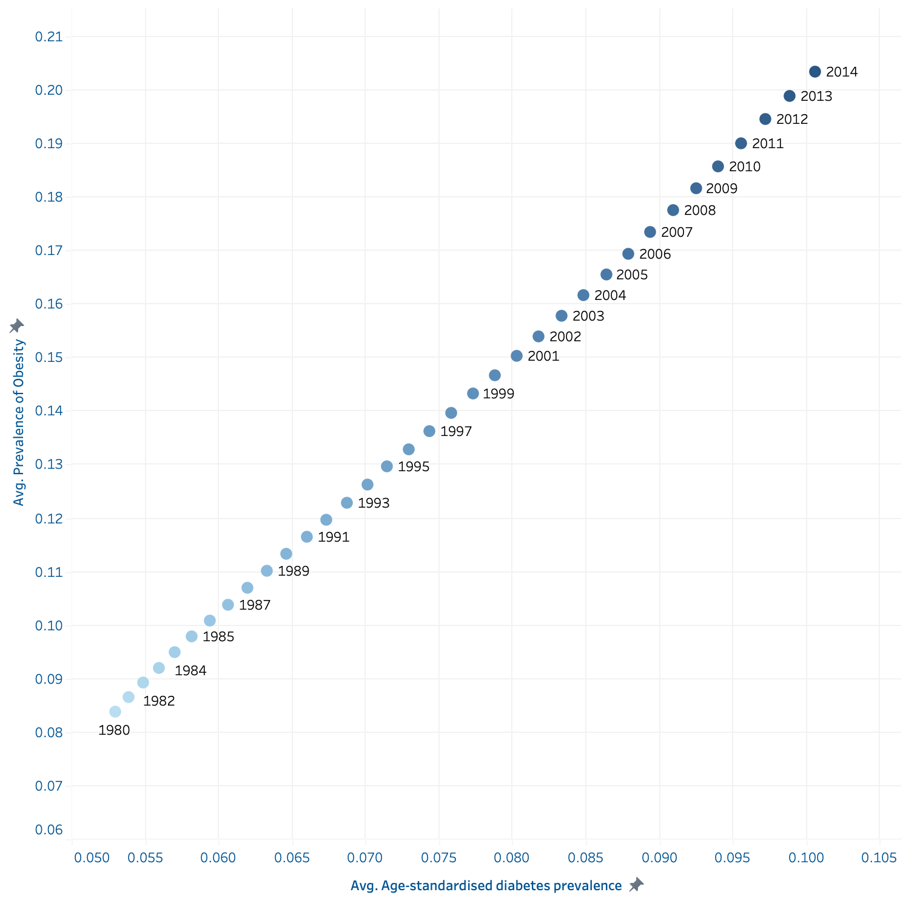
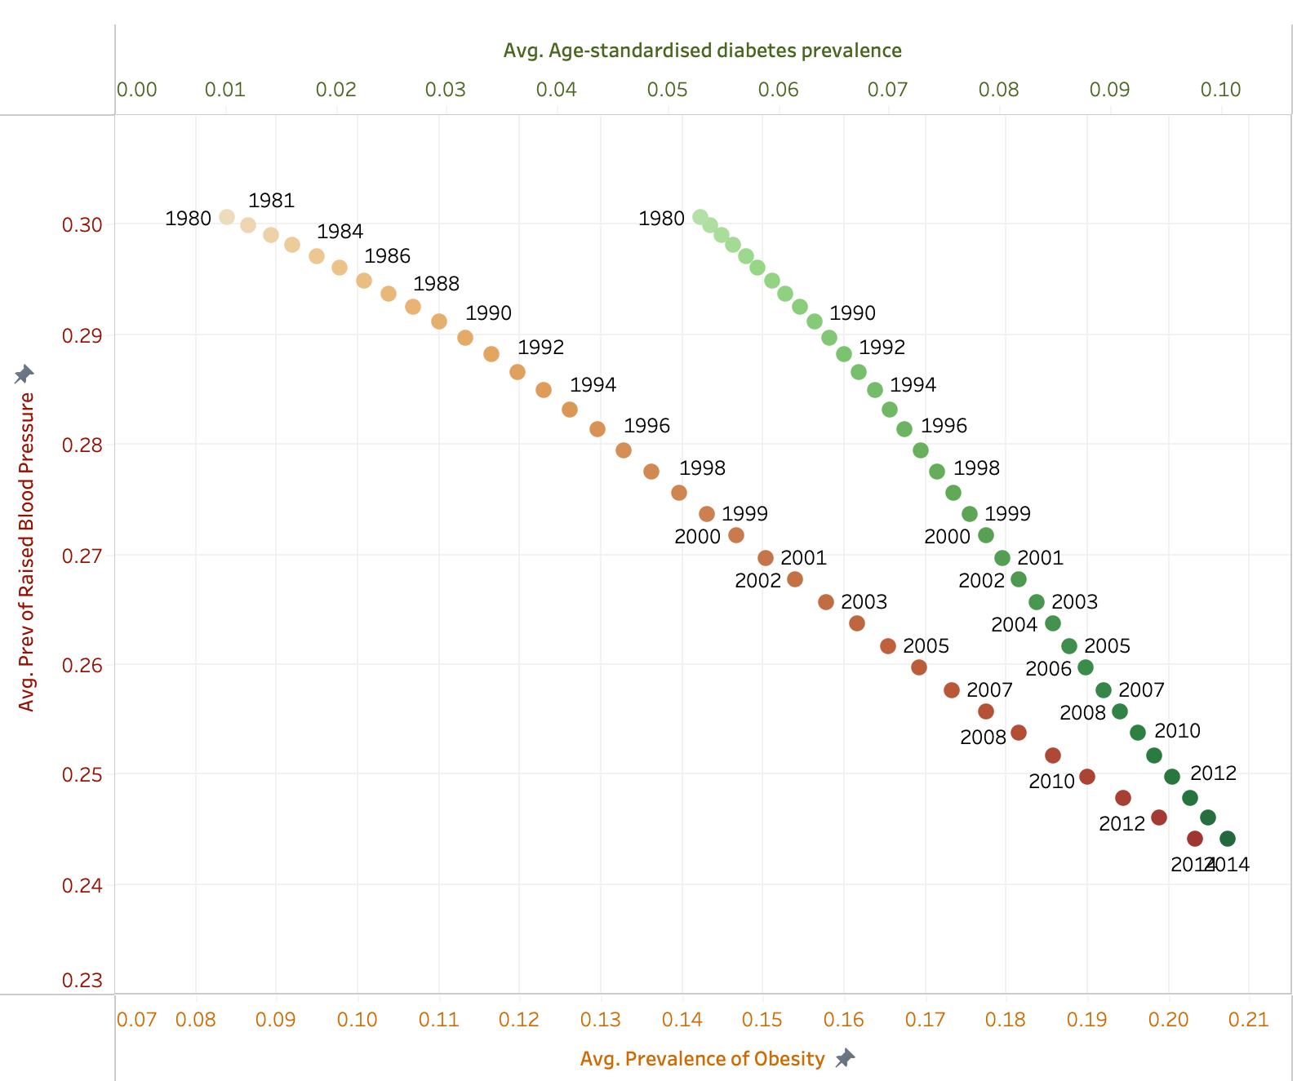
The overall trends in Obesity, Diabetes and Raised Blood Pressure of the whole world from 1980 to 2014, and their relationships
Overall, in the world, the prevalence of obesity and diabetes had a strong positive correlation over the years, while the prevalence of raised blood pressure had a notable negative correlation with both.

Slide 8
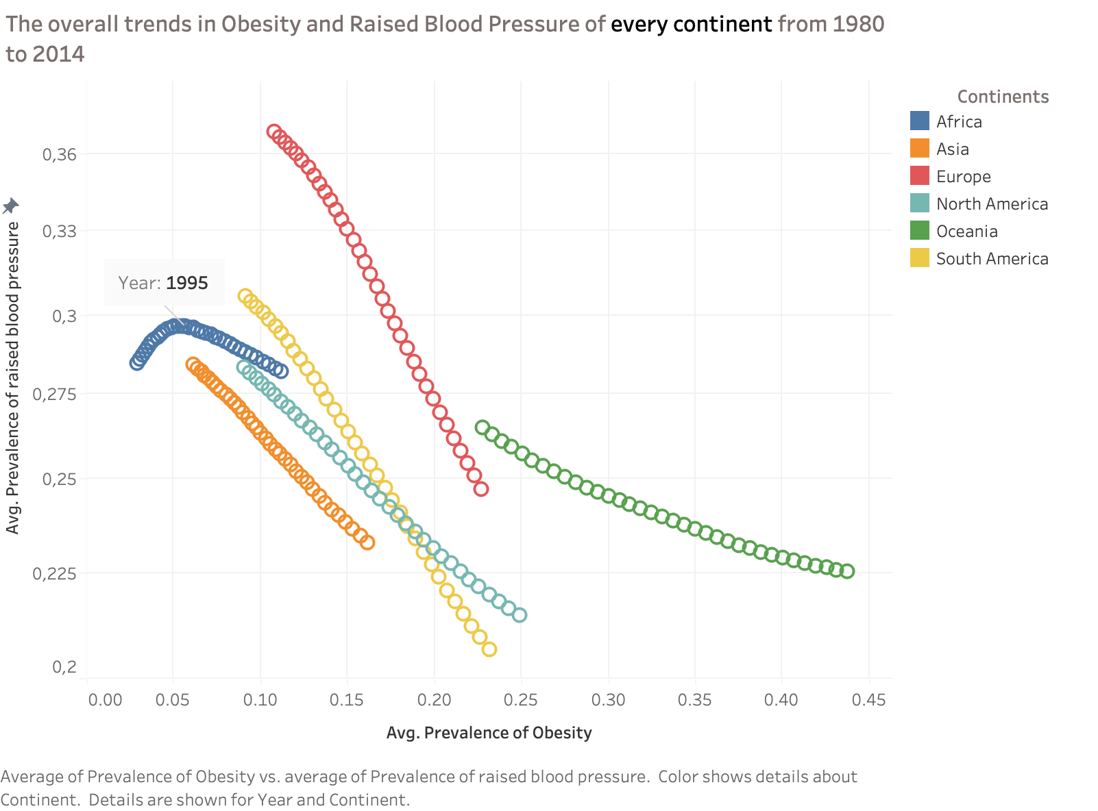
LOOKING AT EVERY CONTINENT
Most continents have the same negative correlation between the prevalence of raised blood pressure and obesity, except for Africa.
Why is there difference in Africa?
Let’s look at that!

Slide 9
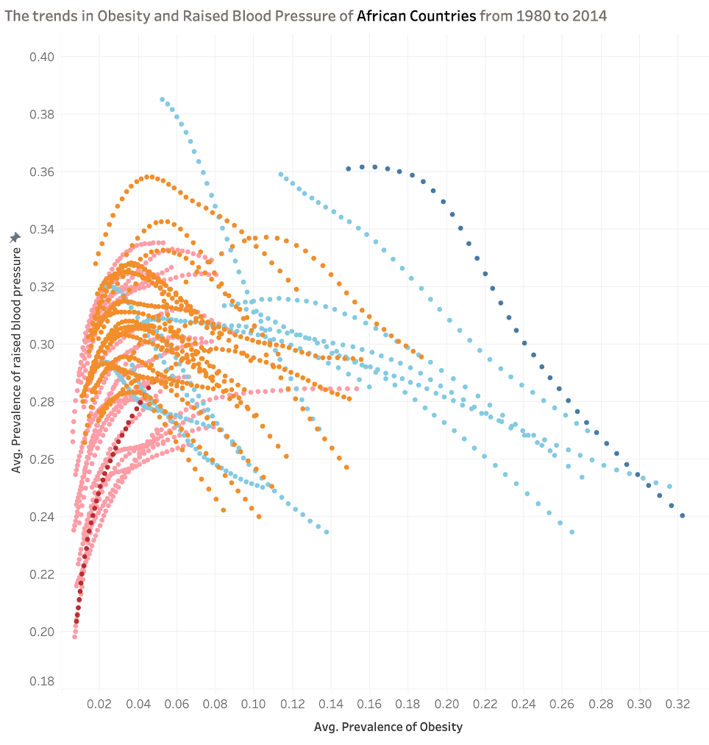
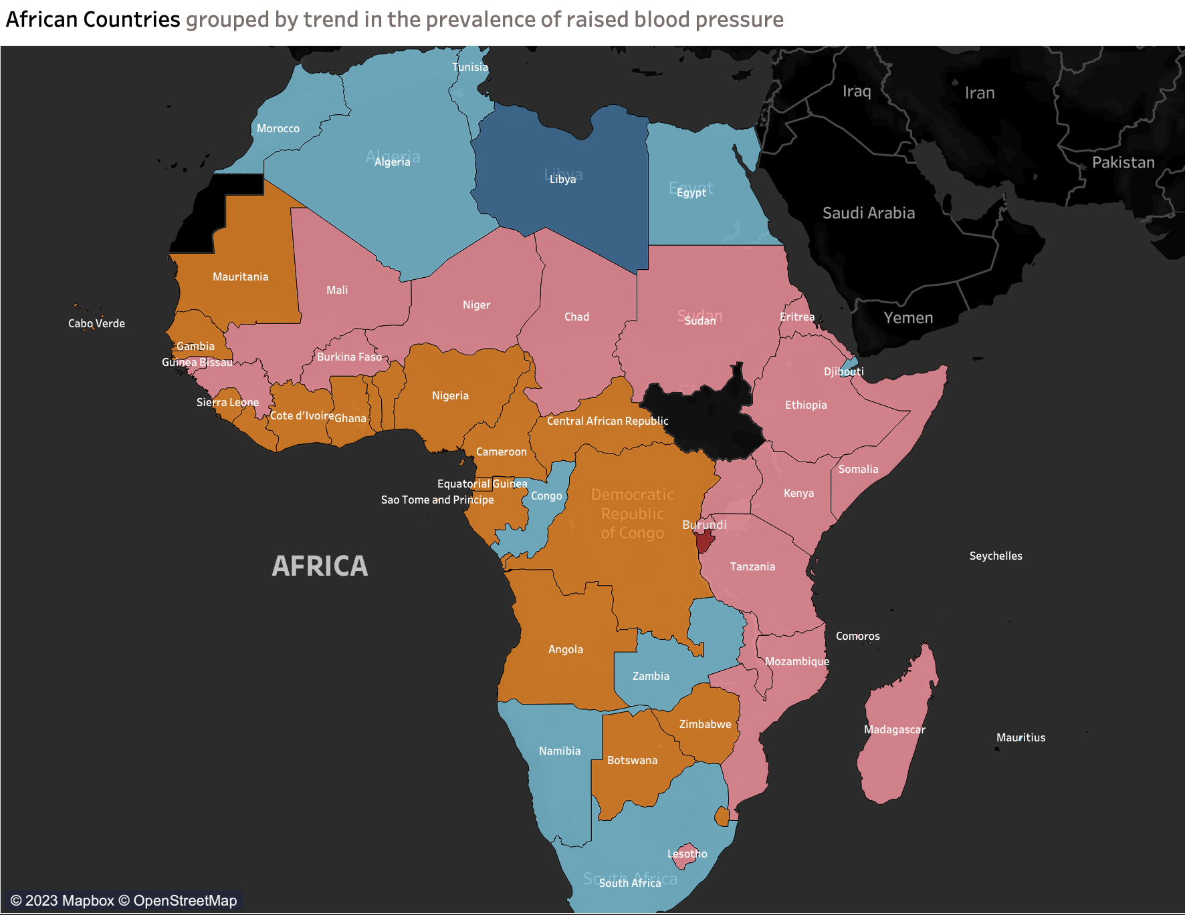
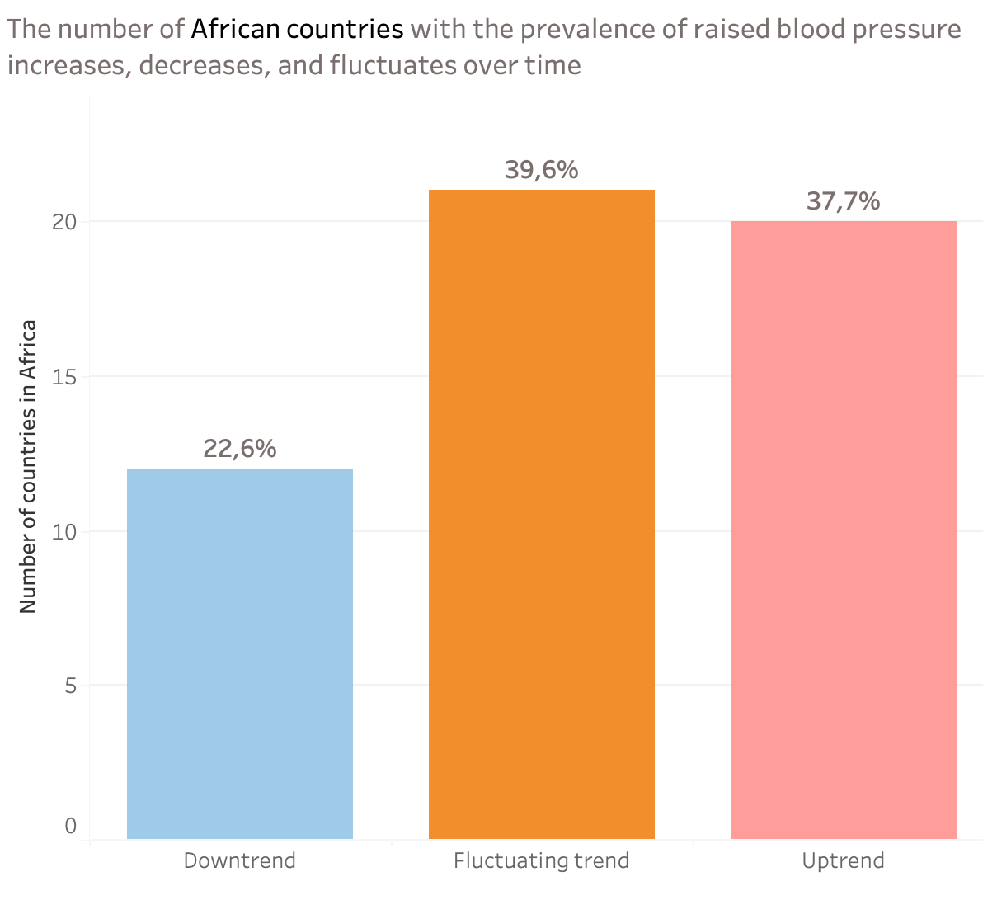
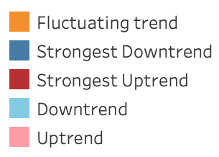
LOOKING AT EVERY AFRICAN Country
All African countries had a shared upward trend in obesity while different trends emerging on the prevalence of raised blood pressure.
Most of them witnessed a fluctuation in raised blood pressure.

Slide 10
THANKS FOR LISTENING!

